Slide 1

Linear Equations in Linear Algebra
THE MATRIX EQUATION

Slide 2


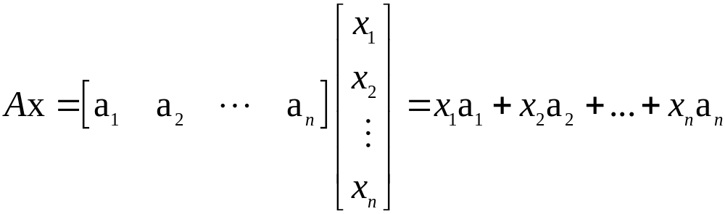
MATRIX EQUATION
Definition: If A is an matrix, with columns a₁, …, a_{n}, and if x is in , then the product of A and x, denoted by Ax, is the linear combination of the columns of A using the corresponding entries in x as weights; that is,
.
Ax is defined only if the number of columns of A equals the number of entries in x.

Slide 3

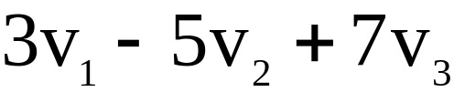

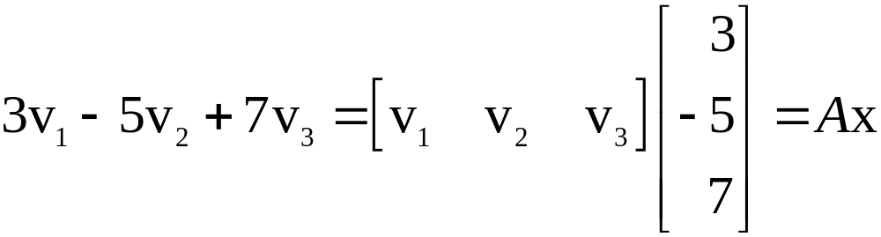
MATRIX EQUATION
Example 1: For v₁, v₂, v₃ in , write the linear combination as a matrix times a vector.
Solution: Place v₁, v₂, v₃ into the columns of a matrix A and place the weights 3, , and 7 into a vector x.
That is,
.

Slide 4
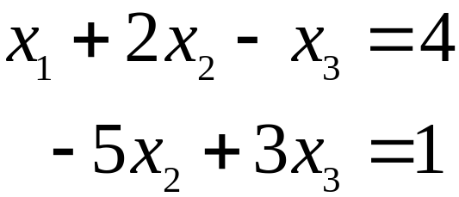
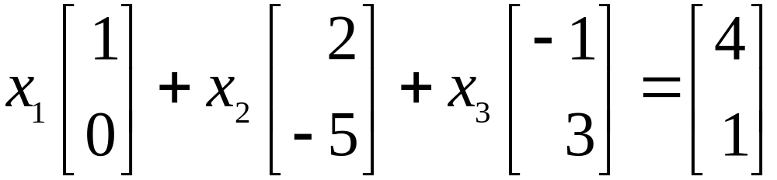
MATRIX EQUATION
Now, write the system of linear equations as a vector equation involving a linear combination of vectors.
For example, the following system
----(1)
is equivalent to
. ----(2)

Slide 5
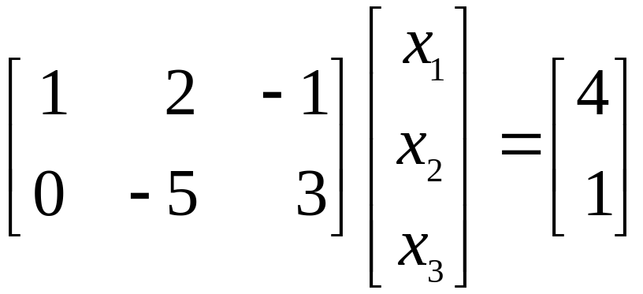

MATRIX EQUATION
As in the given example (1), the linear combination on the left side is a matrix times a vector, so that (2) becomes
. ----(3)
Equation (3) has the form . Such an equation is called a matrix equation.

Slide 6
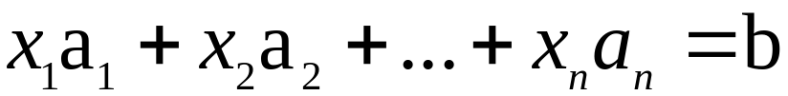
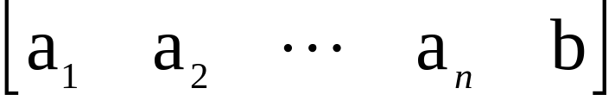
MATRIX EQUATION
Theorem 3: If A is an matrix, with columns a1, …, an, and if b is in , then the matrix equation
has the same solution set as the vector equation
,
which, in turn, has the same solution set as the system of linear equations whose augmented matrix is
.

Slide 7

EXISTENCE OF SOLUTIONS
The equation has a solution if and only if b is a linear combination of the columns of A.
Theorem 4: Let A be an matrix. Then the following statements are logically equivalent. That is, for a particular A, either they are all true statements or they are all false.
    For each b in , the equation has a solution.
    Each b in is a linear combination of the columns of A.
    The columns of A span .
    A has a pivot position in every row.

Slide 8
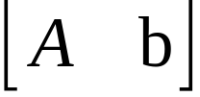

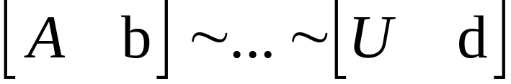
PROOF OF THEOREM 4
Statements (a), (b), and (c) are logically equivalent.
So, it suffices to show (for an arbitrary matrix A) that (a) and (d) are either both true or false.
Let U be an echelon form of A.
Given b in , we can row reduce the augmented matrix to an augmented matrix for some d in :
If statement (d) is true, then each row of U contains a pivot position, and there can be no pivot in the augmented column.

Slide 9
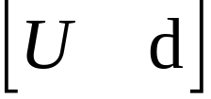
PROOF OF THEOREM 4
So has a solution for any b, and (a) is true.
If (d) is false, then the last row of U is all zeros.
Let d be any vector with a 1 in its last entry.
Then represents an inconsistent system.
Since row operations are reversible, can be transformed into the form .
The new system is also inconsistent, and (a) is false.

Slide 10
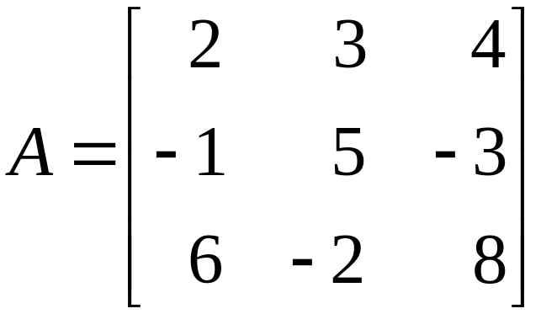
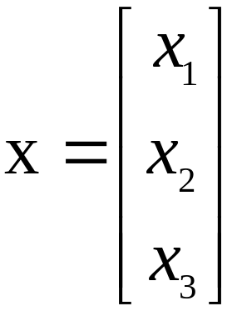
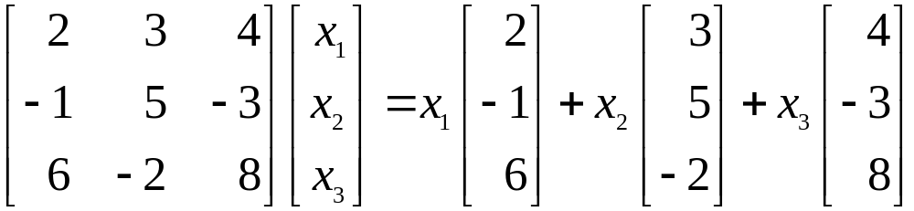
COMPUTATION OF Ax
Example 2: Compute Ax, where
and .
Solution: From the definition,

Slide 11
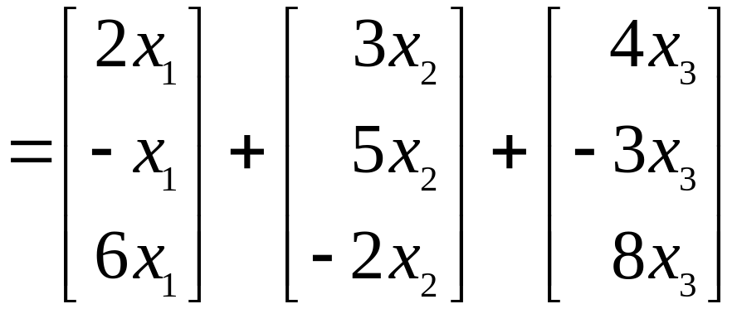
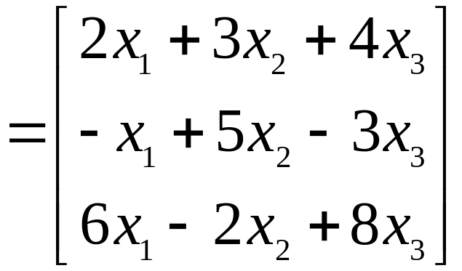
COMPUTATION OF Ax
---(1)
.
The first entry in the product Ax is a sum of products (a dot product), using the first row of A and the entries in x.

Slide 12
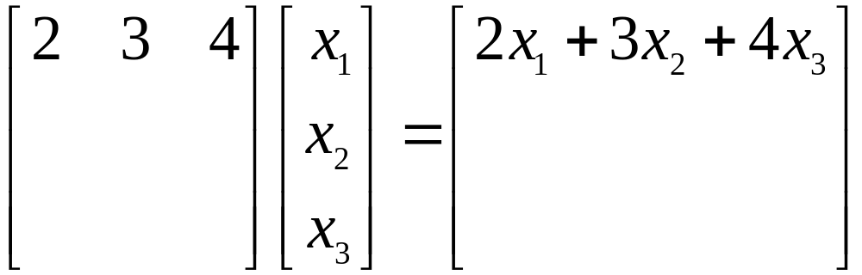
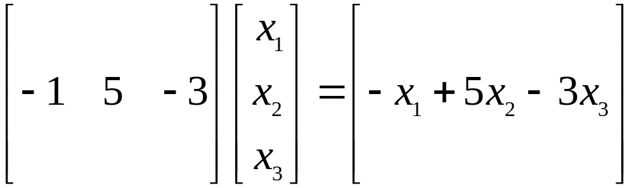
COMPUTATION OF Ax
That is, .
Similarly, the second entry in Ax can be calculated by multiplying the entries in the second row of A by the corresponding entries in x and then summing the resulting products.

Slide 13
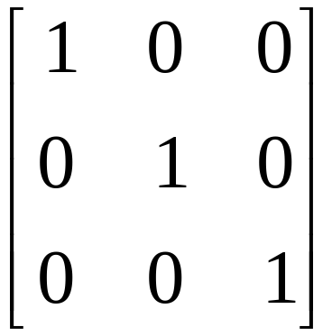
ROW-VECTOR RULE FOR COMPUTING Ax
Likewise, the third entry in Ax can be calculated from the third row of A and the entries in x.
If the product Ax is defined, then the ith entry in Ax is the sum of the products of corresponding entries from row i of A and from the vertex x.
The matrix with 1s on the diagonal and 0s elsewhere is called an identity matrix and is denoted by I.
For example, is an identity matrix.

Slide 14



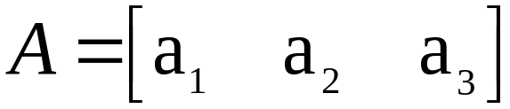


PROPERTIES OF THE MATRIX-VECTOR PRODUCT Ax
Theorem 5: If A is an matrix, u and v are vectors in , and c is a scalar, then
    .
Proof: For simplicity, take , , and u, v in .
For let u_{i} and v_{i} be the ith entries in u and v, respectively.

Slide 15


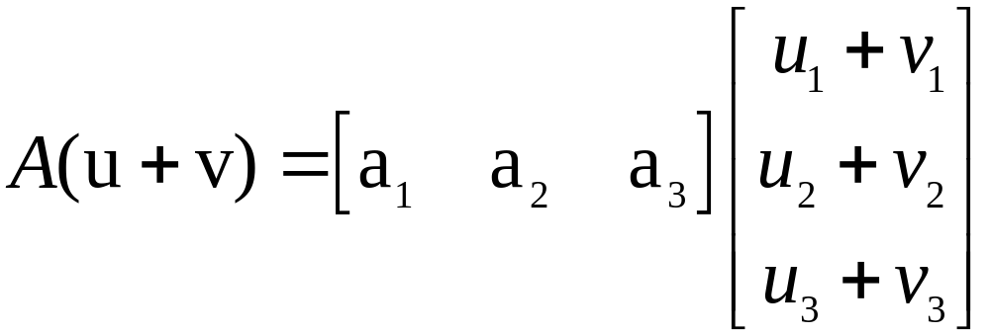


PROPERTIES OF THE MATRIX-VECTOR PRODUCT Ax
To prove statement (a), compute as a linear combination of the columns of A using the entries in
as weights.
Entries in
Columns of A

Slide 16

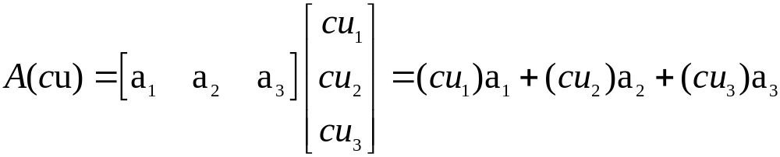
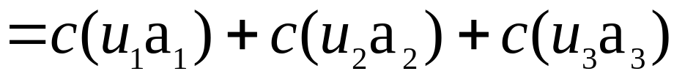
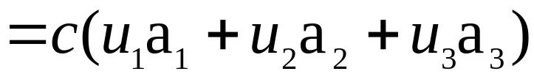

PROPERTIES OF THE MATRIX-VECTOR PRODUCT Ax
To prove statement (b), compute as a linear combination of the columns of A using the entries in cu as weights.

